Slide 1

Experience Downtown Plan Update
City Council Briefing
March 10th, 2025

Slide 2
PLAN BACKGROUND
2016 Plan, Why the Update

Slide 3

2016 Experience Downtown Plan
Built upon the 2009 Imagine Downtown Colorado Springs Master Plan
Includes “Plan of Development” and traditional “Master Plan”
Guides development choices, catalytic projects, and more
Set out to create a plan for a world class city

Slide 4
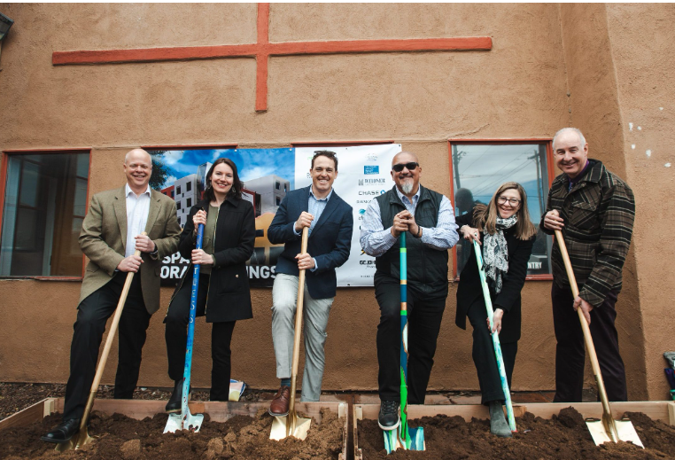
Why Update the Plan?
Implementation progress and have met many goals
Significant growth and planning for additional growth
Navigating post-pandemic and other major events
Serving downtown as more of a neighborhood and urban center

Slide 5



Project Team
Project Management
Land Use
Parks, Trails, Waterways
Public Realm & Urban Design
Management and Maintenance
Economic Vitality
Land Use
Catalytic Opportunities
Mobility & Connectivity
Parking
Trails

Slide 6
PLAN UPDATE
Purpose, Scope, Schedule

Slide 7
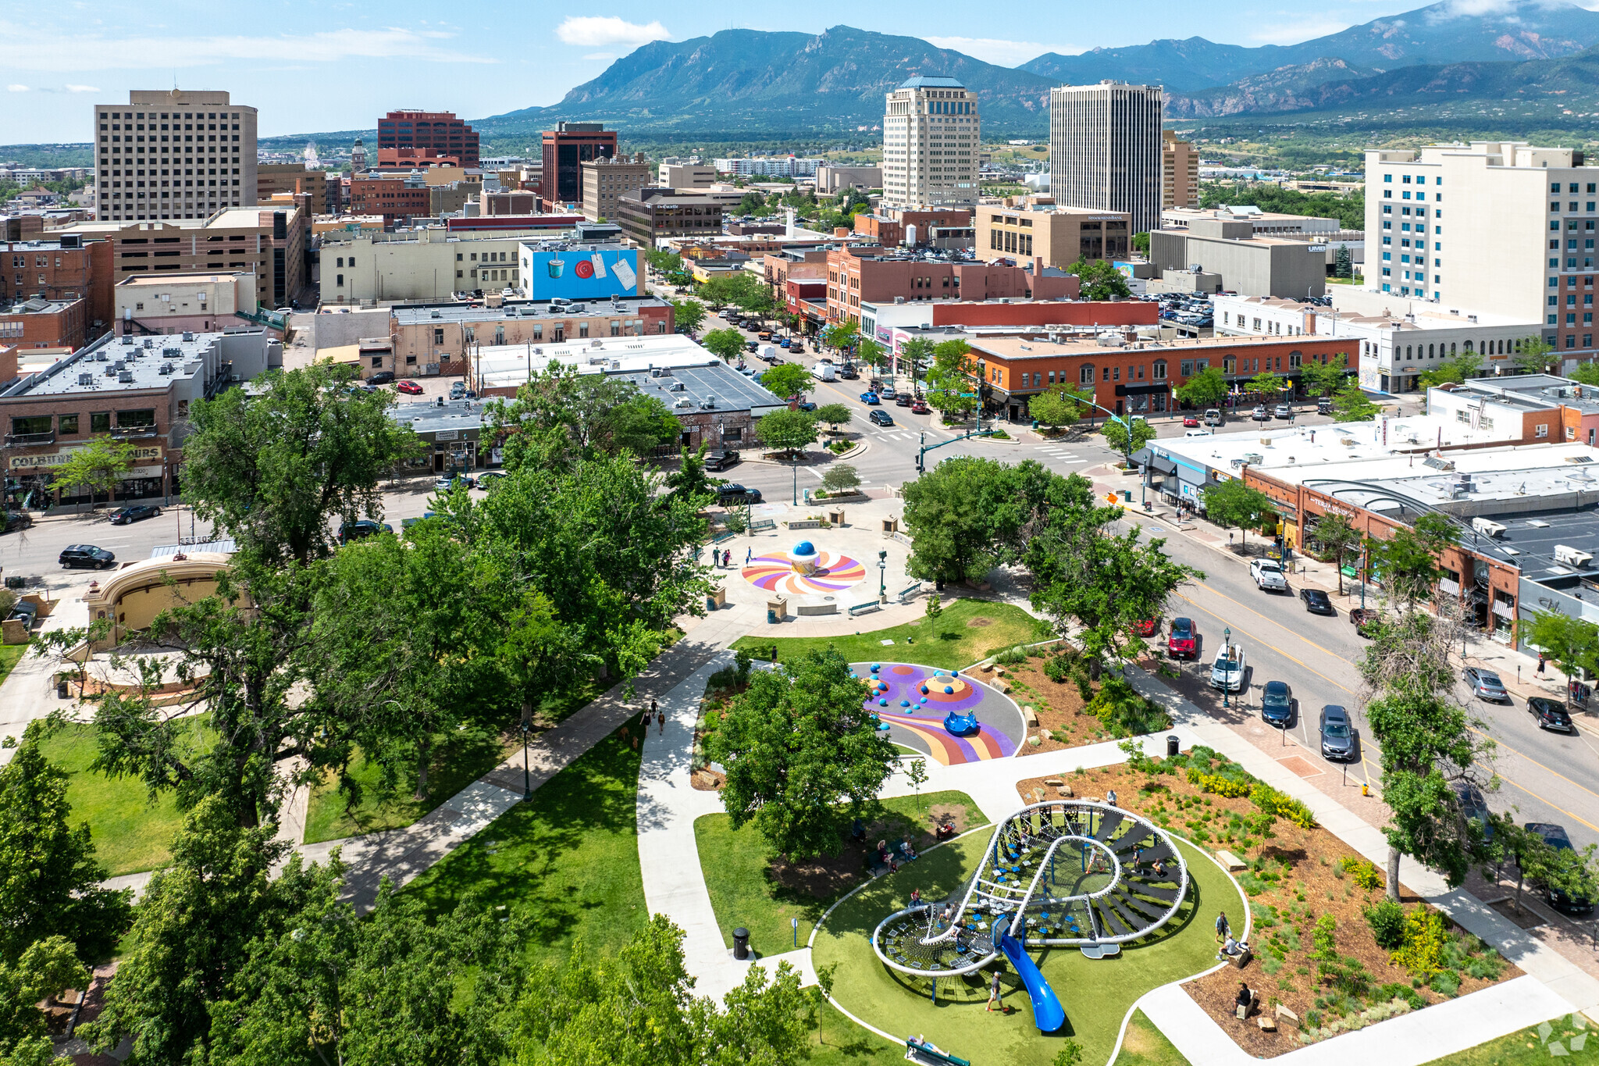
Scope
Update the Plan of Development
Assets, Opportunities, Challenges
Vision, Goals, Action Items
Catalytic Opportunities
Update the Master Plan
Land Use & Urban Design
Parks, Trails, Waterways
Mobility, Connectivity
Market-based Implementation
Rooted in Community Engagement

Slide 8
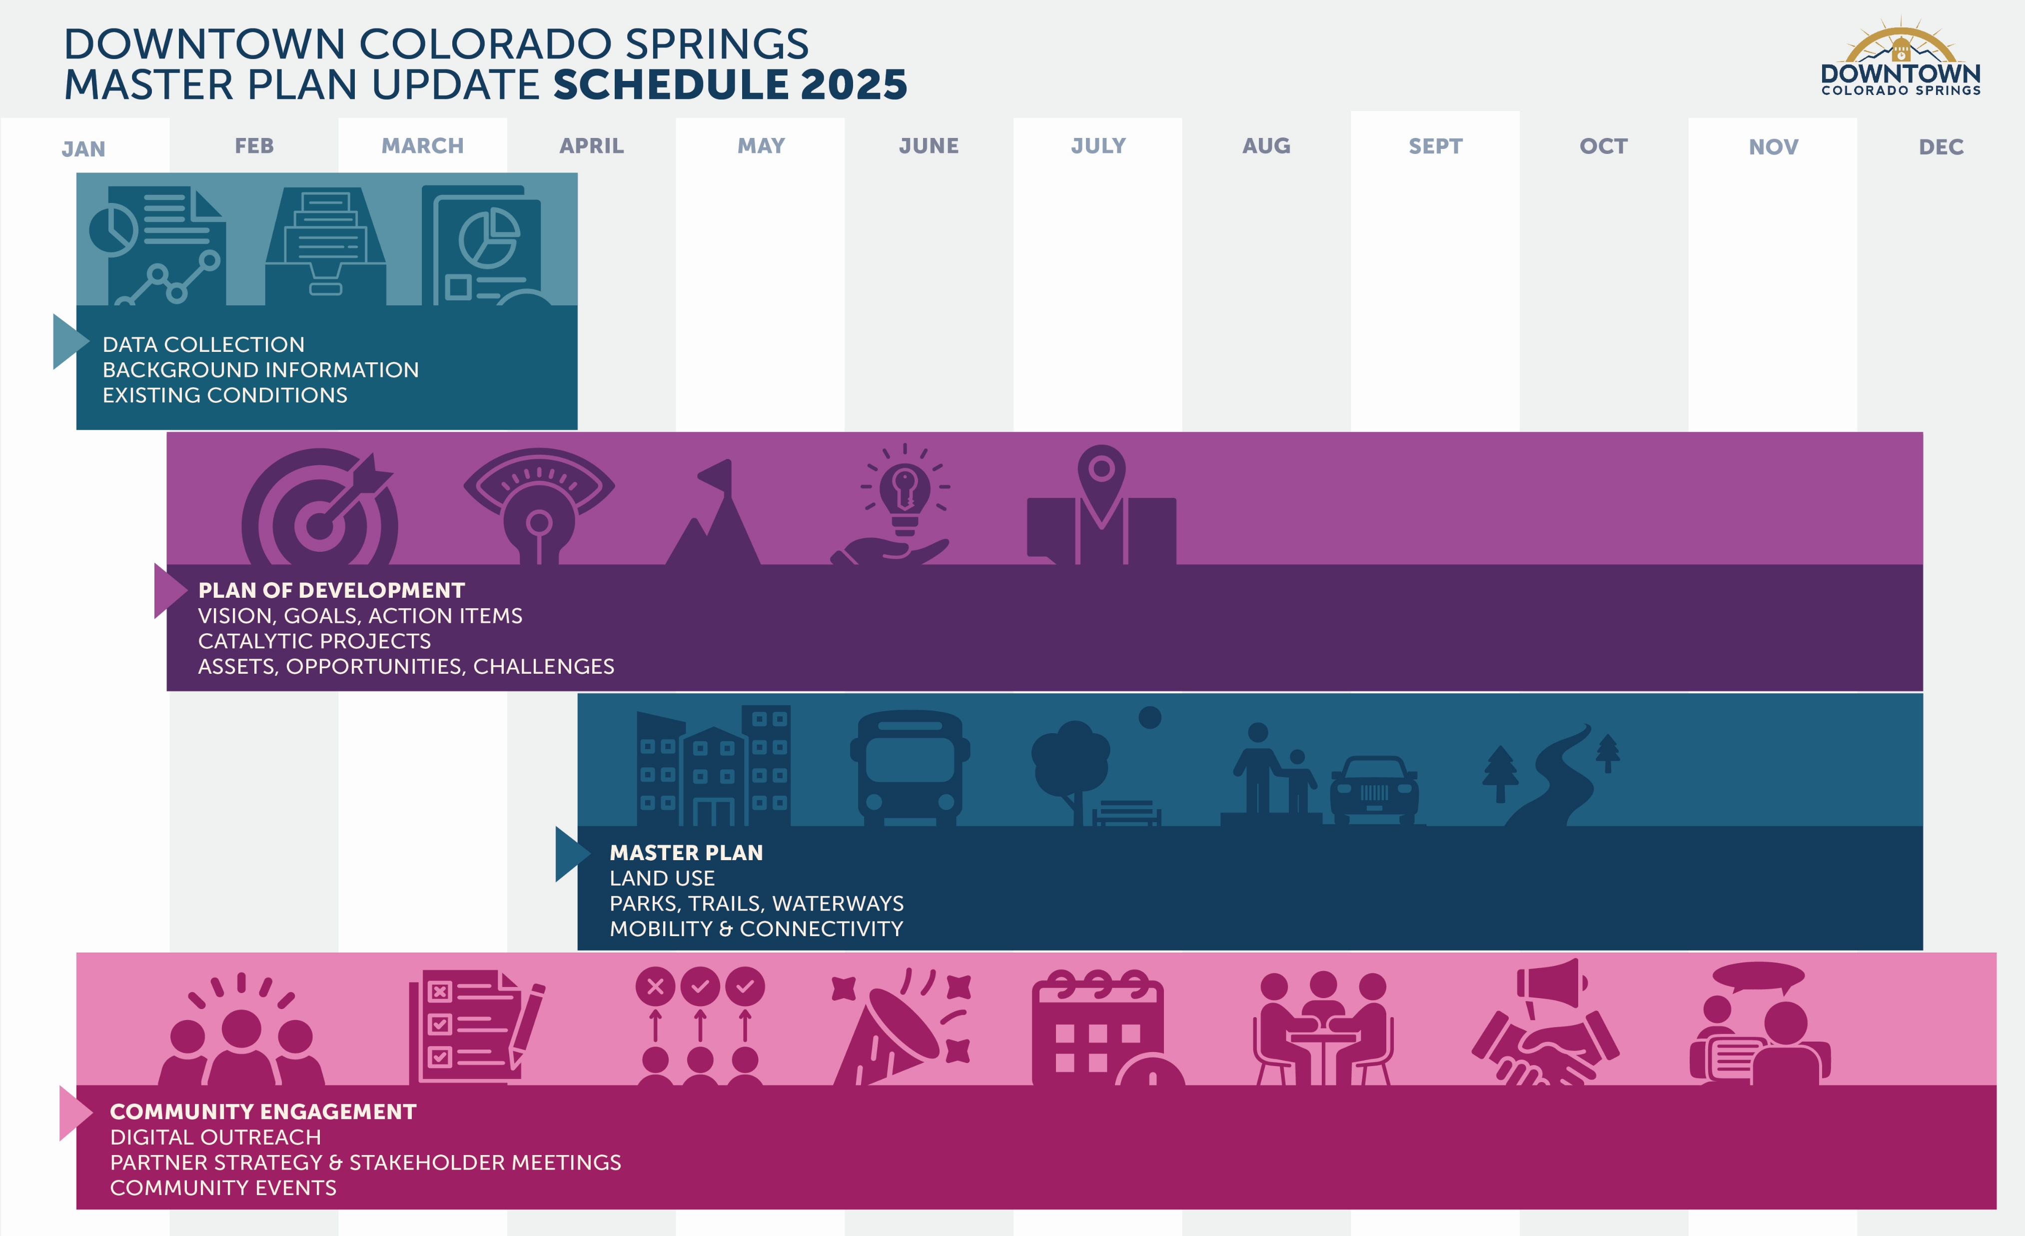

Slide 9
Community Engagement
Stakeholder Interviews and Focus Groups (February, April)
Downtown residents and neighborhood representatives
Education, library, and institutions
Office and large employers
Arts, events, and culture
Small businesses
Developers, property owners, and districts
Housing and homelessness
Mobility, transit, and parking
Notes:
Virtual small groups in Feb, in-person large groups in April

Slide 10
Community Engagement
Community Survey (Feb 5- March 5)
In-Person Community Events (April, September)
Non-traditional formats: Walk & Talk, Coffee & Chat, Block Party
Interactive Platform for Draft Plan Public Review
Notes:
Survey: Focused on vision, opportunities, and challenges. Can update on number of responses and share key findings as separate report.
Events: First two will focus on assets, opportunities, challenges. Block party in Sept will focus on review and contribute to plan strategies and priorities.

Slide 11
Community Engagement
Partner Strategy Meetings (January, May, September)
Downtown Partnership (DDA, BID, DV) + City Council representative
City Council, Planning Commission, and Downtown Review Board
DDA Board Meetings
Notes:
City Council #2 – report out on engagement and draft materials
City Council #3 – final presentation and approval

Slide 12
Experience Downtown Plan Update
City Council Briefing
March 10th, 2025

